Slide 1

Theoretical Approaches in Psychology
Theories and Schools of Thought

Slide 2
Major Approaches To Psychology
Behavioral
Cognitive
Psychodynamic
Gestalt
Humanistic
Sociocultural/
contextual

Slide 3
BEHAVIORISM
Behaviorism became the dominant school of thought during the 1950s.
Holds that all behavior can be explained by environmental causes, rather than by internal forces
Behaviorism is focused on observable behavior.
Theories of learning including classical conditioning and operant conditioning were the focus of a great deal of research.

Slide 4
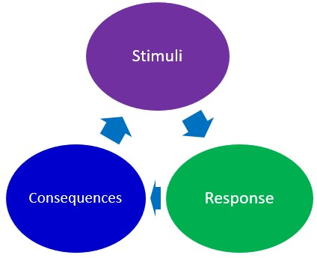
BEHAVIORISM
Classical Conditioning:
John B. Watson: Albert and the White Rat
Ivan Pavlov: Dog and Salivation
Edward Thorndike: Cat and Food
Operant Conditioning:
B. F. Skinner: Positive and Negative Reinforcement

Slide 5
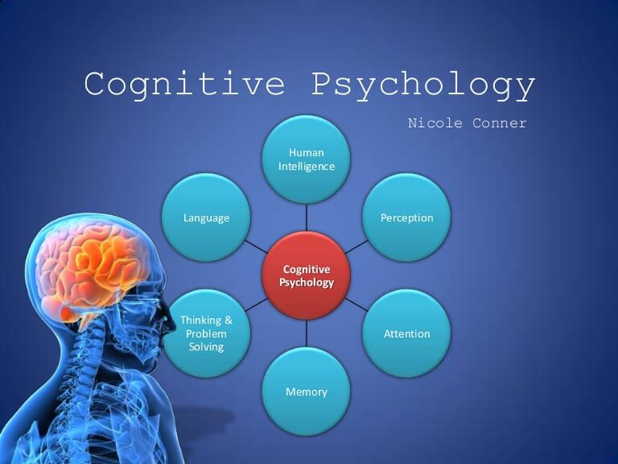
COGNITIVE
Cognitive Revolution
Studies mental processes including how people think, perceive, remember, and learn
Stages of cognitive development theory proposed by Jean Piaget
Understanding the mind through scientific experimentation
Became more predominant during the period between the 1950s and 1970s

Slide 6
COGNITIVE
Jean Piaget’s Stages of Cognitive Development:
Universal across cultures, same invariant order
All children go through the same stages in the same order (but not all at the same rate)

Slide 7
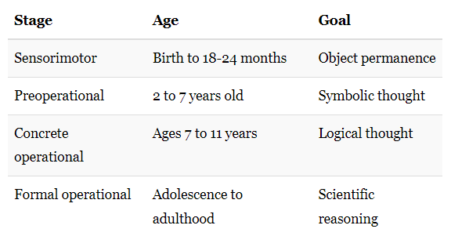
COGNITIVE
Jean Piaget's theory of cognitive development suggests that children move through four different stages of intellectual development which reflect the increasing sophistication of children's thought
Schema of objects → Association with Language, Feelings
Intellectual, Egocentric, Intuitive, Animism
Decentring, Inclusion Tasks, Can Mentally Reverse Things, tend to make mistakes or be overwhelmed when asked to reason about abstract or hypothetical problems
Higher-Order Reasoning, freed from physical and perceptual constraints, logical argument

Slide 8
PSYCHODYNAMIC
Psychological forces underlying human behavior, feelings, and emotions
Psychodynamics originated with Sigmund Freud in the late 19th century
Interpretive methods, introspection and clinical observations, focused on resolving unconscious conflict, mental distress
Assumes that much of mental life is unconscious, and that past experiences, especially in early childhood, shape how a person feels and behaves throughout life

Slide 9
PSYCHODYNAMIC
Most psychodynamic approaches use talk therapy, or psychoanalysis, to examine maladaptive functions that developed early in life
Psychoanalysis is a type of analysis that involves attempting to affect behavioral change through having patients talk about their difficulties
Free association:
Dream Interpretation
Hypnosis
Freudian Slips

Slide 10
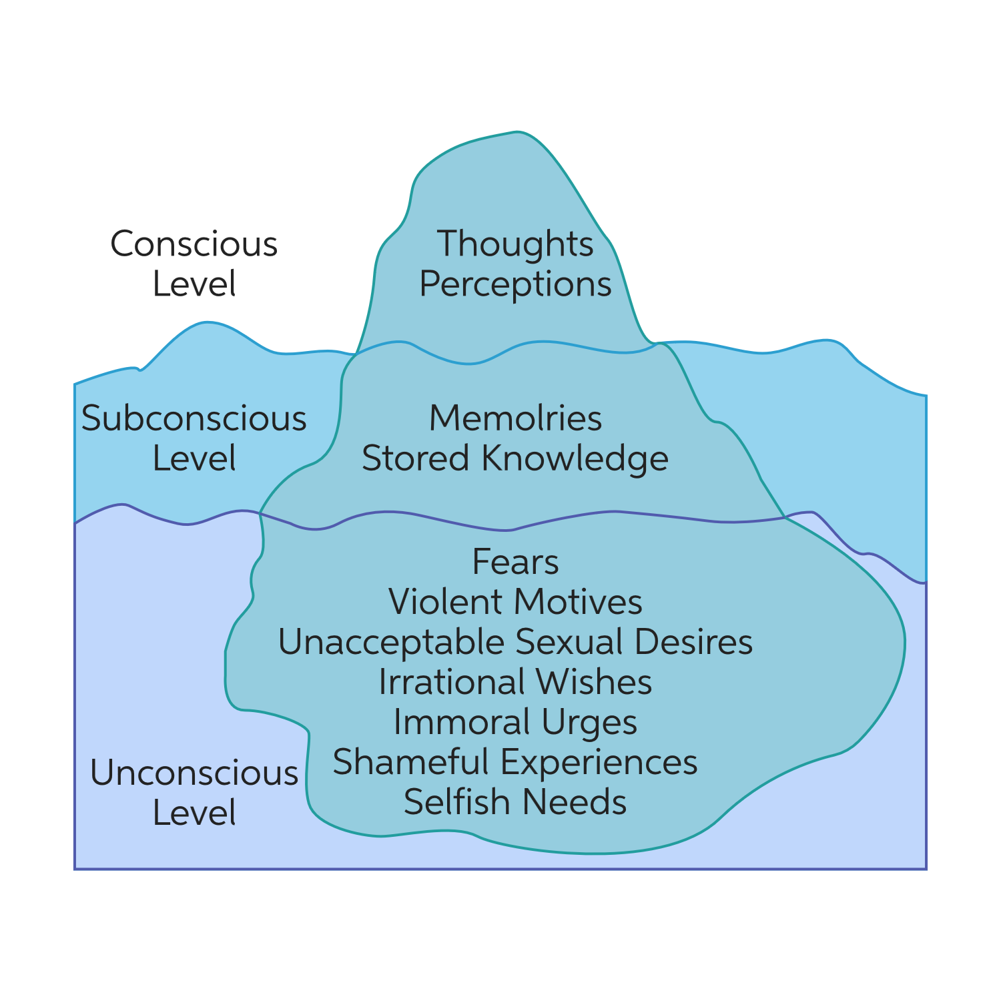
PSYCHODYNAMIC LEVELS of Consciousness
Conscious
Sub-Conscious
Unconscious

Slide 11
GESTALT
Means ‘Configuration’, or ‘structure’
Based upon the idea that we experience things as unified wholes.
How the human brain perceives experience
Look at the whole of experience than breaking down thoughts and behavior to their smallest element
According to the gestalt thinkers, the whole is greater than the sum of its parts.

Slide 12
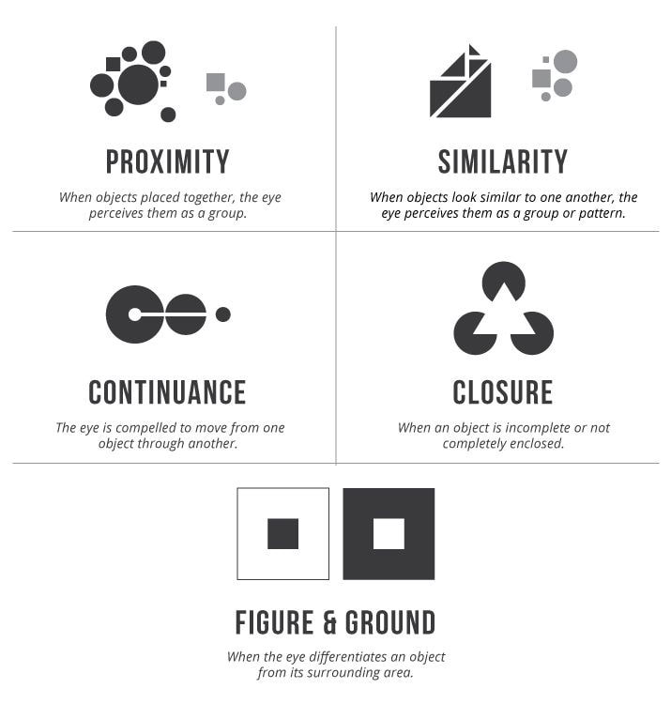
GESTALT
Laws of Perception - explain how this behavior of “pattern seeking” operates
human brain tends to automatically organize and interpret visual data through grouping

Slide 13



GESTALT
Proximity
Closure
Similarity

Slide 14


GESTALT
Continuation
Figure and Ground

Slide 15
HUMANISTIC
Emphasizes looking at the whole person
Uniqueness of each individual
Begins with the existential assumptions → free will, motivated to achieve their potential, and self-actualize.
Developed as a response to psychoanalysis and behaviorism
Both behaviorism and psychoanalysis are regarded as dehumanizing by humanistic psychologists.

Slide 16
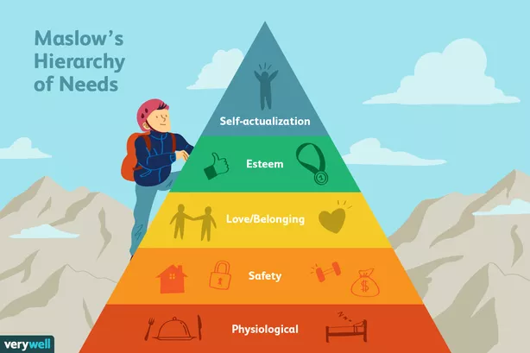
HUMANISTIC
people have free will
People are basically good, and have an innate need to make themselves and the world better
People are motivated to self-actualize
The subjective, conscious experiences of the individual is most important

Slide 17
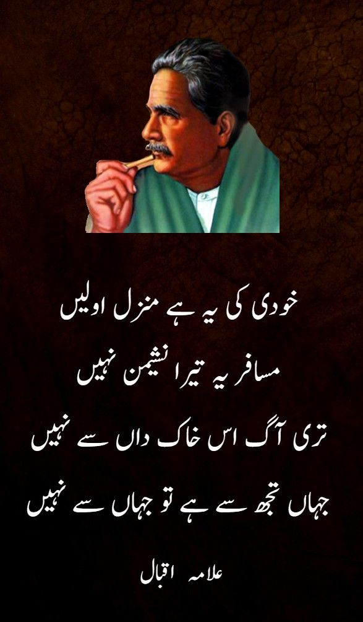
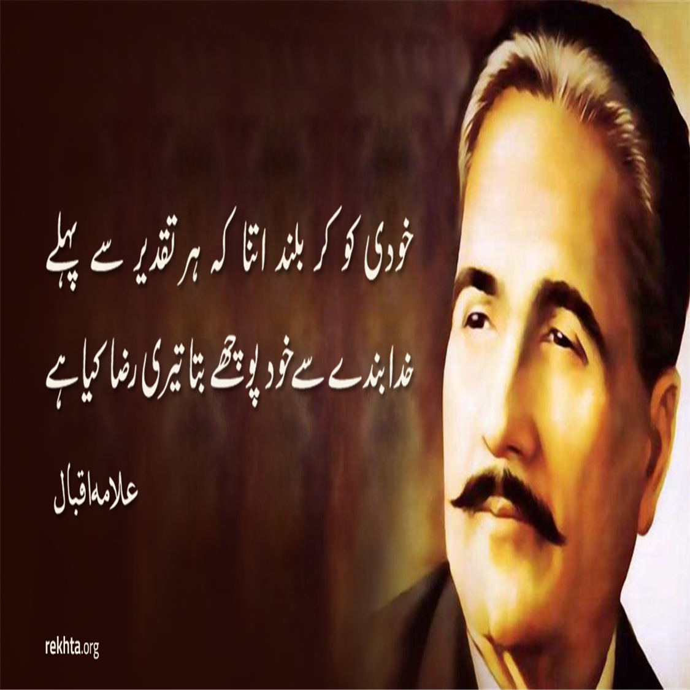
HUMANISTIC

Slide 18
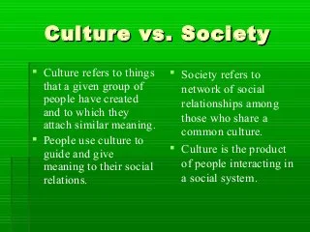
SOCIOCULTURAL
Explains how individual mental functioning is related to cultural, institutional, and historical context
Focus of the sociocultural perspective is on the roles that participation in social interactions and culturally organized activities play in influencing psychological development.
three main assumptions:
1) the interdependence between person and culture
2) intersubjectivity as constitutive of the self
3) the self as a developing agent

Slide 19
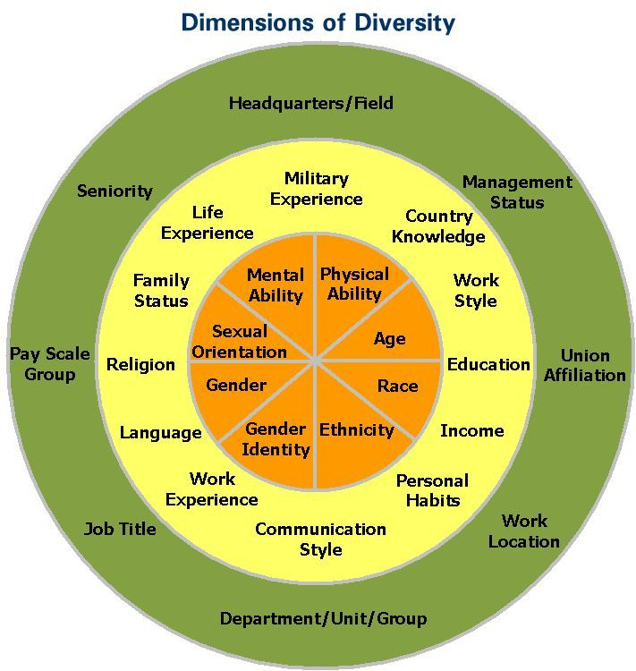
SOCIOCULTURAL
Understands cognition, emotion, memory, identity, personality, and other psychological constructs as relational entities that emerge out of interactions with others within a sociocultural context
By adopting a universalistic and deterministic perspective on social thinking, it has constructed human behavior as such
Common Sense
Discourses Construct Reality
Ethnocentric
Mob-Mentality and Peer Pressure

